Slide 1

Community Service Hours
x2VOL.com
Student Login

Slide 2
Access x2VOL through Family Connection
Sign into Family Connection.
  If you need your Family Connection login information contact your school admin.
Click on the x2VOL link under the Resources on the left hand side of your screen in Family Connection.
Complete your x2VOL profile the first time you access x2VOL.
Click continue to enter x2Vol site.

Slide 3
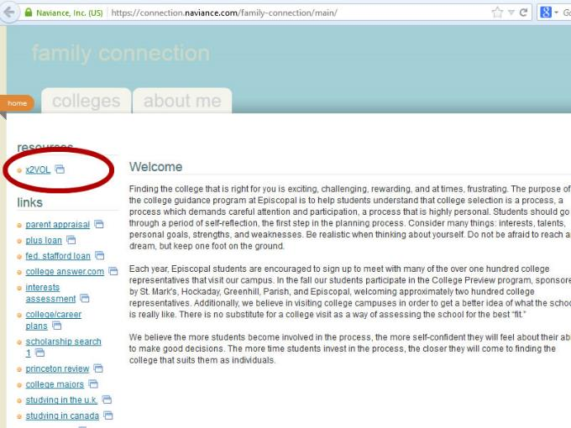
Sign-in through Family Connection
In Family Connection, click on the “x2VOL” link under Resources.

Slide 4
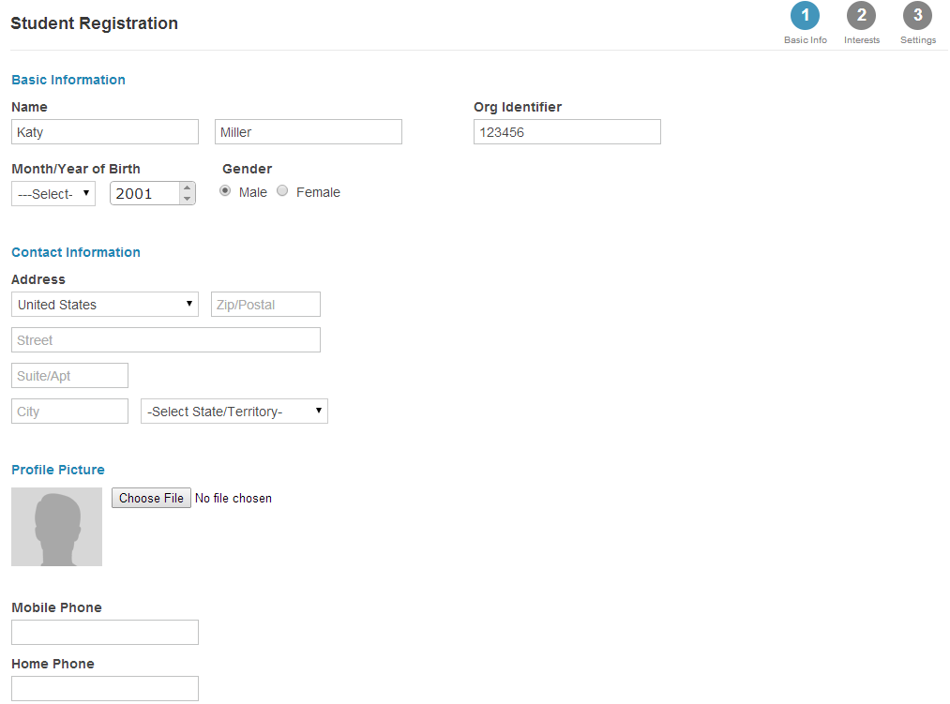
Complete Your Profile
Your information is already listed in your profile.
Add your email address.
Click Proceed

Slide 5
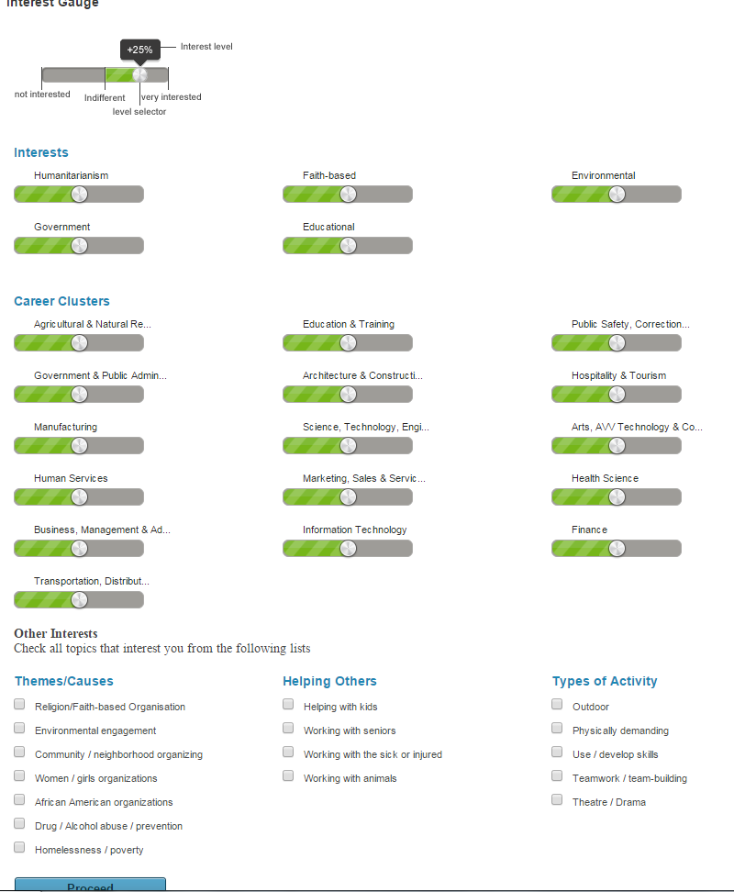
Skip Interest Page and Click Proceed

Slide 6
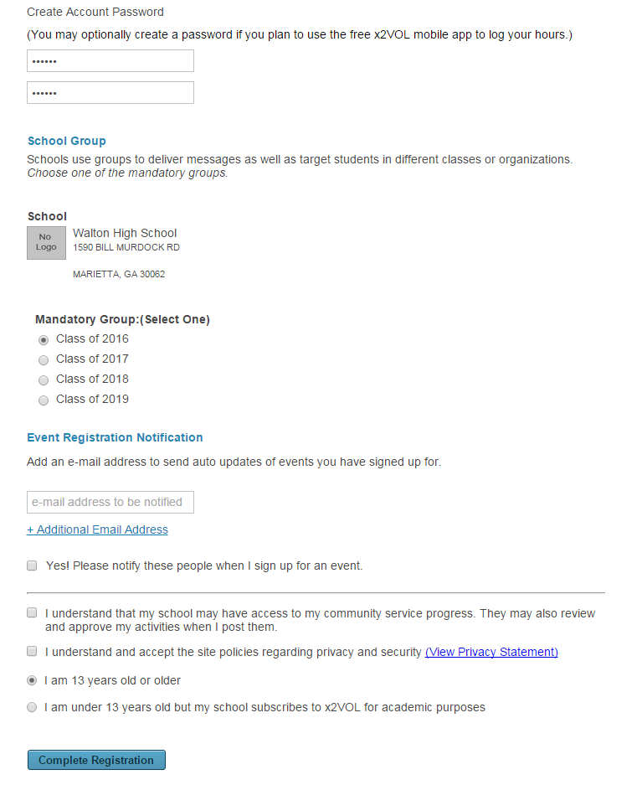
Set Password and Select Class Group
Agree to Terms
Create Account Password
Leave Event Registration Notification Blank
LEAVE BLANK
Click I understand
for the first 2 Boxes
Click Complete
Registration

Slide 7
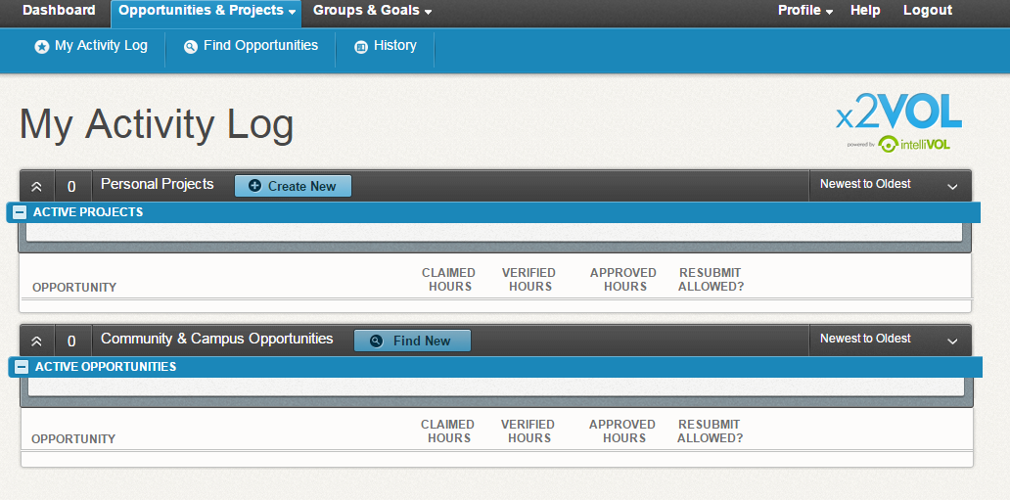
Log Your Service Hours
Click Opportunities and Projects
Click My Activity Log
Create New Under Personal Projects

Slide 8
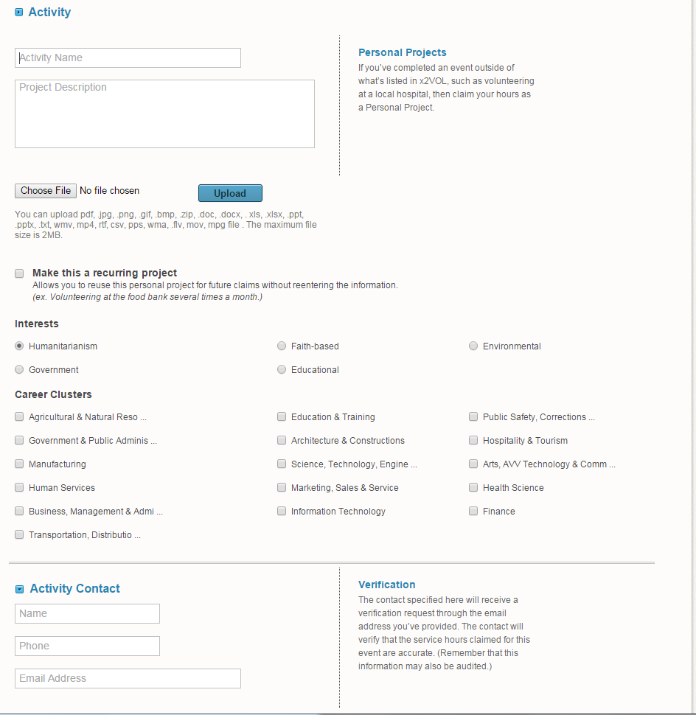
Creating a Personal Project
Create an Activity Name and Project Description
Fill out all of the applicable information
You may click recurring project, interests, and career clusters if you choose.
Very Important:
Enter in Supervisor’s Email Address Under Activity Contact
You do not need to enter phone number!

Slide 9
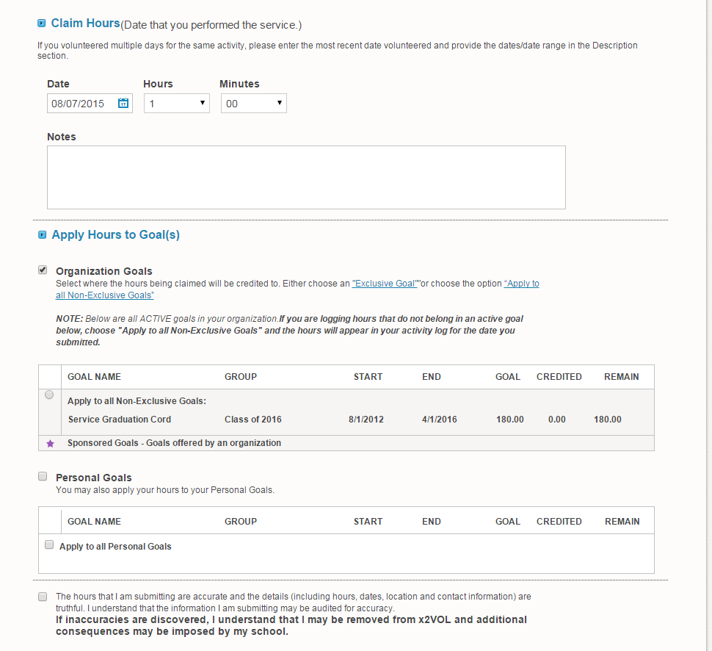
Creating a Personal Project
Enter in the Number of Hours
Click on Organization Goals
Click on Next to Apply to Service Graduation Cord
Click the box to verify that the information is truthful.

Slide 10
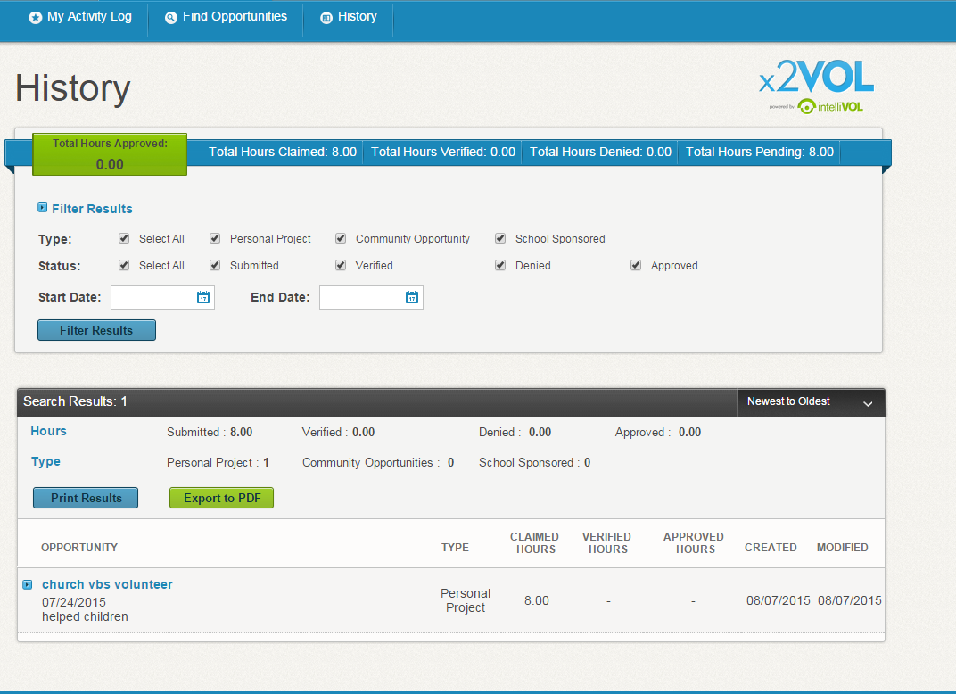
View Service Hour History

Slide 11
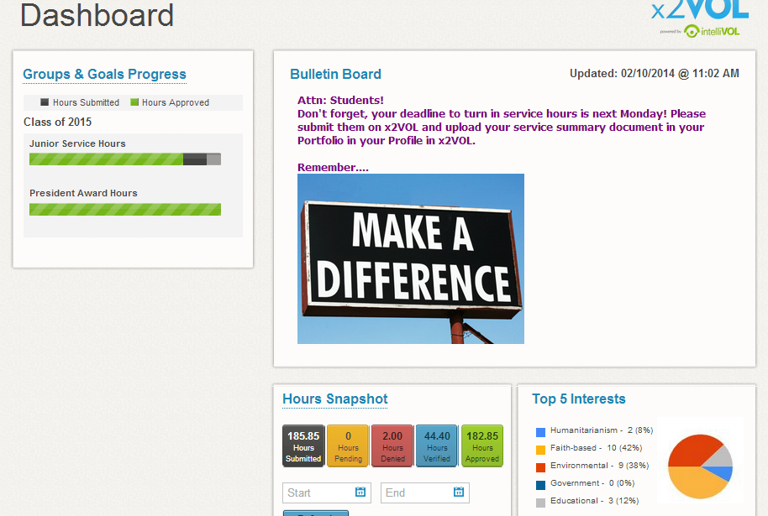
See Snapshot of your x2VOL Account on your Dashboard to see your progress!

Slide 12


Try the x2VOL Free Mobile App!
After you register and login on the web site – try our mobile app to log your hours!

Slide 13

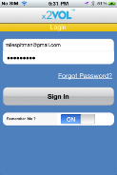
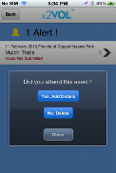
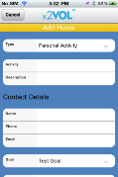
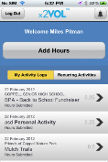
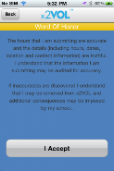
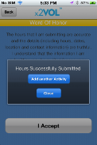
Mobile App Screens
Note: You must login at least once on the web site before you can use the free x2VOL mobile app. The app is for logging hours only.

